Slide 1


Global & NAFTA Scrap Market Dynamics June 2016
Presenter: John W Harris P.Eng. CEO, Aaristic Services Inc.
Retired Jun 2011, Director Raw Materials, ArcelorMittal
Contact: John.harris@aaristic.com ; +1 705 791 2280
Major areas of John’s expertise:
Scrap Market Expert Witness
Consultant to Investment Markets on Steel & Metallics Industry
Training Modules: Steelmaking, Scrap Yard Optimization, Global Metallics Market Dynamics, Raw Mat’ls’ Competitiveness
ArcelorMittal - Responsible for 700,000 TPY sales of DRI
  & 500,000 TPM scrap purchases in NAFTA
Arcelor Mittal – Published internal Weekly Global Scrap Market Reports Performed Due Diligence for Metallics on AM expansion

Slide 2
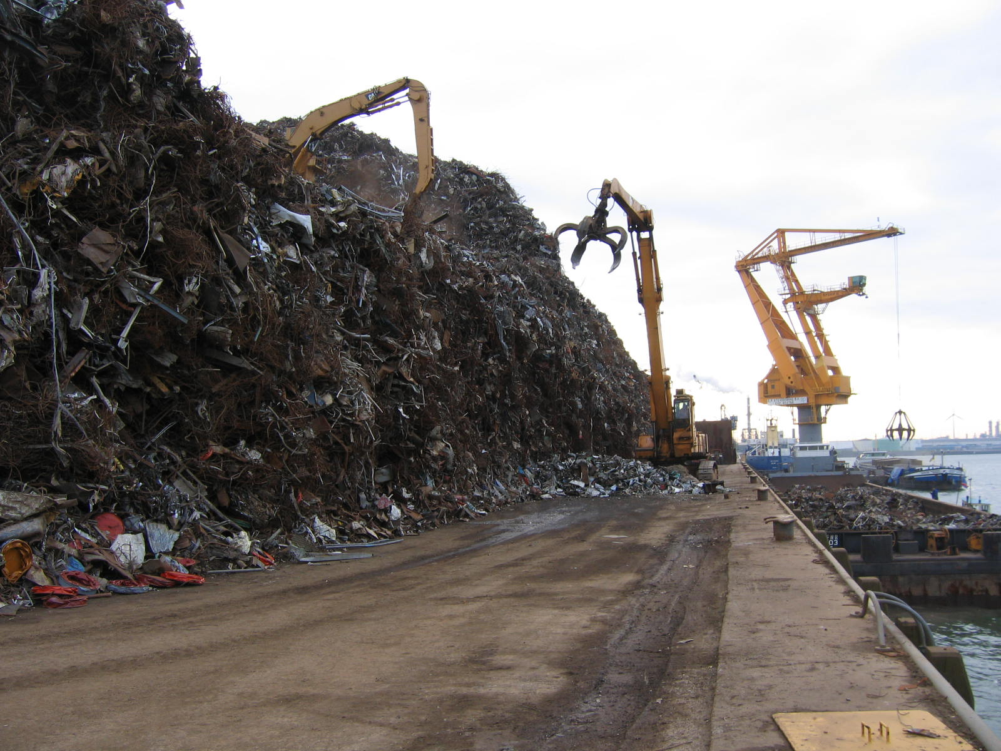
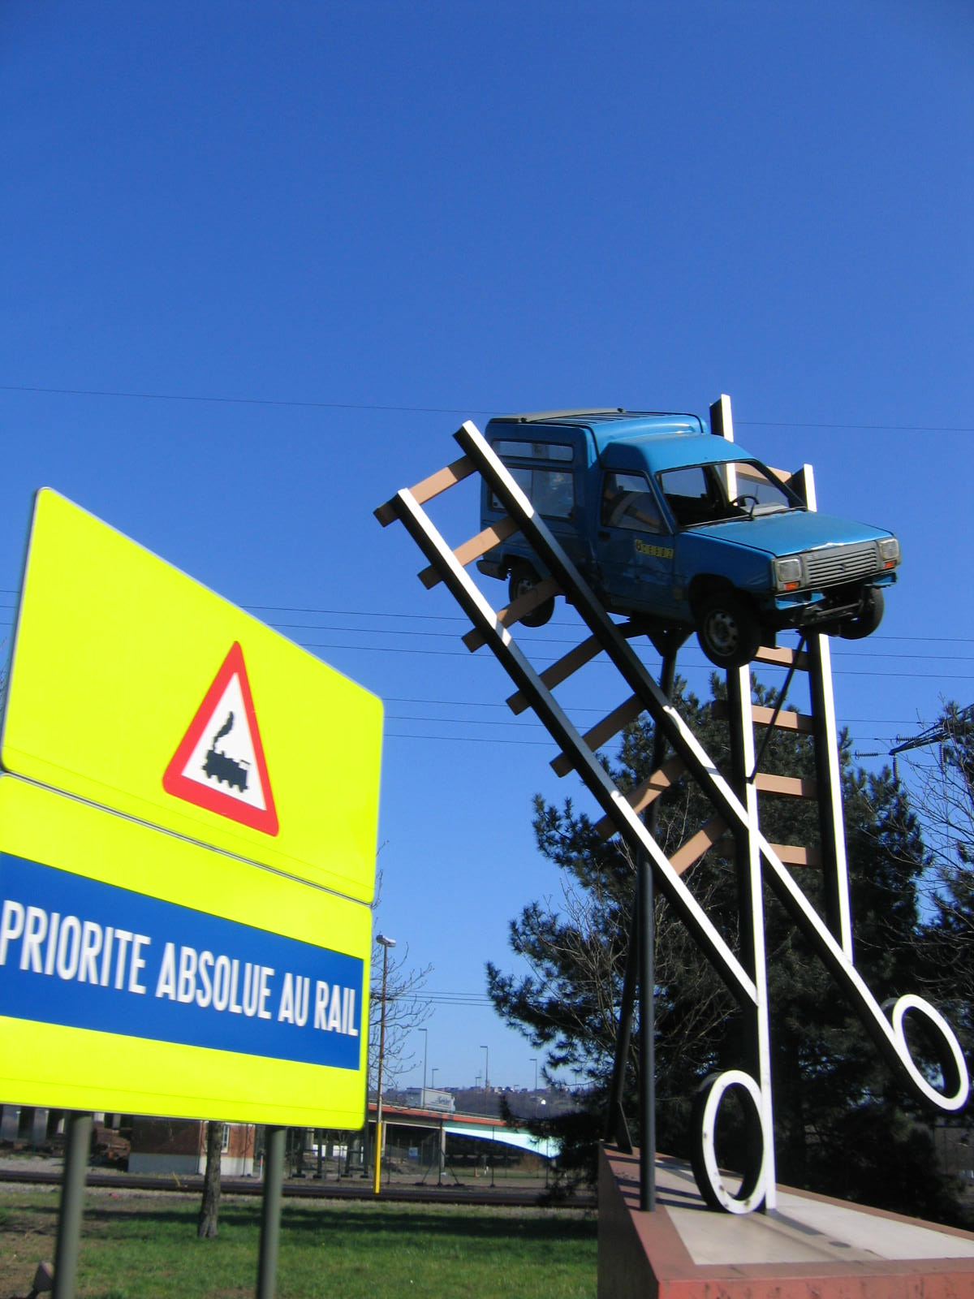
Global & NAFTA Steel/Scrap Market Dynamics Jun 2016
Awareness
is Absolutely Necessary!

Slide 3

Worldwide Steel Production
2015 ~ 1.599 B mt --- down 47Mt (3%)
CIS (6) 101Mt down 4Mt
EU (28) 166Mt down 4Mt
China 803Mt down 20Mt
Canada 12Mt
NAFTA 110Mt
down 10Mt
USA 79Mt
Turkey 32Mt down 2Mt
Japan 105Mt down 5Mt
India 90Mt up 3Mt
Taiwan 21Mt down 2Mt
Africa 16Mt
Asia 1096Mt down 25Mt
S. America 44Mt down 1Mt
Australia 5Mt

Slide 4



2015 Global & NAFTA
Raw Mat’ls & Production
Data Resources WSO, SteelHome,
SSY Reports
12.45
78.91
18.25
Scrap usage declining as DRI increases to 6Mt

Slide 5
Global factors affecting NAFTA steelmakers
Strong US$ Motivating steel imports & reducing scrap exports
China exports 60% rebar 112Mt 2015 -- 91Mt 2014 -- 45Mt 2013
China & WTO Market Economy Status end 2016 (WTO)
Market Prices Jun 7-16 Oil: $51.39/bbl. Gas: $2.44/MMBTU
Iron ore: $50.60/Dmt – Rio Tinto, CVRD, BHP
India Steel growth area 89.5 Mt 2015 (10% Increase on 2014)
Iran Embargo lifting 16 M mt 2015 (DRI driven - intentions to export)
Turkey Reduced scrap imports 16.25Mt 2015 (NAFTA down to 3.57Mt)
EU 28 Exporting scrap & steel to NAFTA to offset heavy steel imports from China & Russia
Political & economic strife (Brexit, Greece, Italy, Spain, etc.)
Ukraine & Russian influence
Low Vessel Shipping Rates Bulk cargo vessels @ >10% surplus
NAFTA to EU & Turkey ~$12/mt ---- Vessel scrapping increasing pace

Slide 6
China Factors affecting
Global Steelmakers
China – 2015 steel prod. 803 Mt; consumption <720 Mt
China - utilization rate @ 80% (requires reduction >20%)
China – Internal prompt scrap at surplus (~100 Mt)
China – Exports mainly long products (60% rebar)
China – BFs have cost advantage over NAFTA & EU ~$50/mt
(China <20 yrs. & >4200 m3; NAFTA & EU ~35 yrs. & <3800m3)
China concerns – shutting capacity means shutting down towns:
water, power, services etc. + Increasing unemployment
(alternative: reducing utilization rates to <60%)
China – Instituted Anti Corruption Mandate; auditing plants
China – Forcing modifications for environmental protection
(using drones to monitor)
China – Economy: 45% Investment/55% Consumption: (Norm. 20%/80%)
Actions; Raising wages, Exporting products, Improved Housing
~50% Steel prod. investment in High Speed Rail ($130B)
One Belt, One Road

Slide 7
Regional Factors affecting
NAFTA steelmakers
Auto Industry Demand solid for next 2 to 3 years
Int’l Org. Motor Vehicles Manufacturers
2015 ---- 17.4 M units (+5.8% YOY)
2018 ---- 20 M units (Merrill Lynch prediction)
reduced vehicle weights ~ 20% Alum, AHSS & UHSS
Residential -- Housing markets slow recovery
Industrial & Commercial -- Economy - creeping recovery
Oil &Gas -- Excess pipe stock; Persian Dilemma
rig counts --- last week 404 (50% of 2015 count)
Heavy Equipment -- Mining & oil patch cutbacks
Appliances -- Less steel required, imports

Slide 8

Estimated Worldwide
Scrap Flow 2015
Europe *
Export 10Mt
Import 7Mt
CIS
Export 3Mt
Canada
Export 2Mt
Russia
Export: 3Mt
China
Import 1Mt
USA
Export 15Mt
Turkey
Import 18Mt
Japan
Export 7Mt
South Korea
Egypt Import 2Mt
China
India Import 2Mt
Taiwan
Import 6Mt
Taiwan
Australia
Export 2Mt
Approx. 37Mt flowed globally in 2015. Down approx. 15Mt YOY.

Slide 9
NAFTA Scrap Market Challenges
Influencing Factors
NAFTA scrap prices are directly influenced by
Supply Availability/Steelmaker Demand
China Steel exports Billets & Slabs: replaces EAF production
Finished steel products (2015 --- 112 Mt)
Utilization rates: 2015 @ 71% (down from 2014 @ 77%)
Steel imports increased to 38.84Mt
2016 @ 72.1% YTD (last week 75.3%
Steel Import Tariffs Increasing utilization rates: Currently @ 75.3%
Surplus scrap Approx. 10Mt; Exporters selling local
Flat Carbon EAF Using DRI & Pig Iron: HRC & auto exposed grades
Obsolete scrap Flush ---- Expected bottom < $150/gt (Flows die)
Prompt scrap Low availability

Slide 10
NAFTA Steel/Scrap Market Challenges
China’s Dramatic Production Increase
aiding NAFTA recovery
Million mt
(WSO)
(AISI)
Middle Arrow ---- Aug 2008 market’s sudden drop
Top Arrow ---- China’s growth stops, billet & steel are exported
& starts replacing scrap
Bottom Arrow ---- NAFTA’s declining util. rate ~70%

Slide 11
Steel Production
AISI’s NAFTA Steel Production Breakdown 2015 in M mt
NAFTA crude steel production 2015 ~ 109.7 M mt
Utilization rate average @ ~ 71%
Long Products – rebar & wire rod ~ 13.99
- structural & rail ~ 6.04
- semis, other ~ 11.35
Flat Products – pipe, tube, plate ~ 14.79 M mt
- HRC & CRC ~ 41.27 (<0.10%Cu)
- Tin, Galv., Coated ~ 21.02 (<0.10%Cu)
Note: In 2015 Auto Industry consumed
26 M mt or 27% of Steel consumption
2014
Crude 121
Rate ~77%
2016 YTD
Crude 38.8
Rate ~72.1%
31.81 M
29%
77.88
71%
Notes:
Okay

Slide 12
Steel Consumption
AISI’s NAFTA Steel Consumption 2015 in M mt
(Compliments SMA, AISI, WSO)
Total NAFTA steel production 2015 ~ 109.7 M mt
2015 Imports ~ 38.0 M mt
Total NAFTA Steel consumption 2015 ~ 147.7 M mt
Major Sources of 2014 Imports
Asia 51% -Korea 20% - China 15%
- Japan 11% - Taiwan 5%
Turkey 8%
Germany 5% & Russia 5%
India 4%
Other 27%
2015 Imports
25.7%
2013 Imports
15.2%
21.3 M mt
Notes:
Okay

Slide 13

Steelmakers’ Focus:
Expanding Steel Margins & Reducing Costs
Iron Ore/Coke vs Scrap?
BOF vs EAF: <0.10% Cu Flat Carbon Steel
<0.06% Cu Auto Exposed
Targets: Higher value-added products
Competitiveness – market share
Restrict imports -- Trade Cases, Tariff developments & Anti-Dumping
Controlling raw materials supply lines
Cost reduction – TCO (Total Cost of Ownership)
Steel Industry expansion, contraction & consolidation
Notes:
Okay

Slide 14

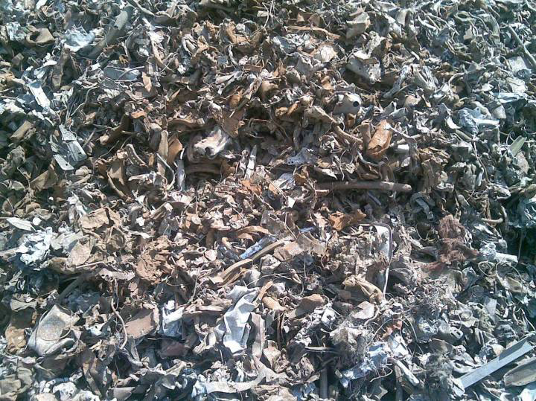
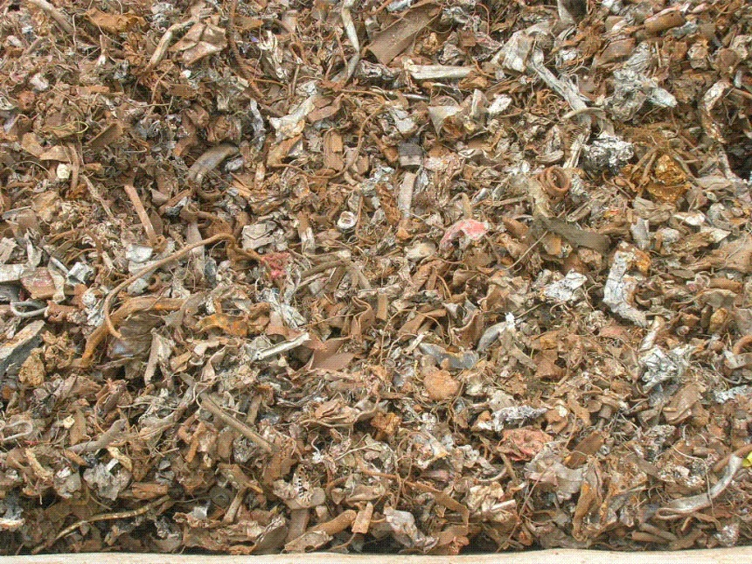
Scrap Grade Characteristics
Grade: Shred
Thickness: >= Max impurities: 0.4%
Dimensions: <= 200mm any direction 95%; balance <1000mm
Shred |  | Scrap Chemical Composition (%)
C | Mn | Si | P | S | Cu
0.4 | <1.65 | <0.35 | 0.04 | 0.06 | 0.17 to <0.30
Cr+Ni+Mo | Sn | Fe |  | Yield | Density kg/m3
<=0.25 | <=0.02 | 95 |  | 90 | 1200 or 75#/ft3

Slide 15
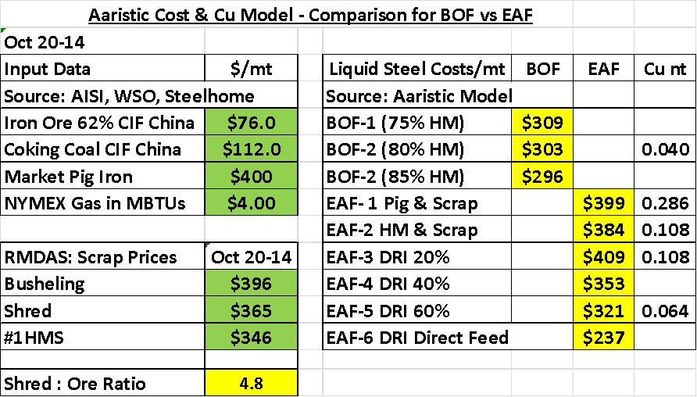
Steel by Iron Ore or Scrap?
Advantage BOF

Slide 16


Steel by Iron Ore or Scrap?
Approaching
Balance
Notes:
Okay

Slide 17
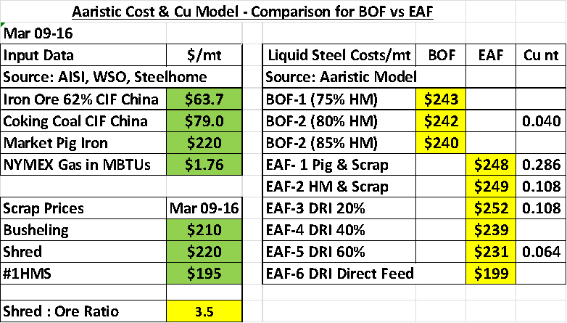
Steel by Iron Ore or Scrap?
Advantage DRI EAF
ON

Slide 18
Steel by Iron Ore or Scrap?
Advantage BOF

Slide 19
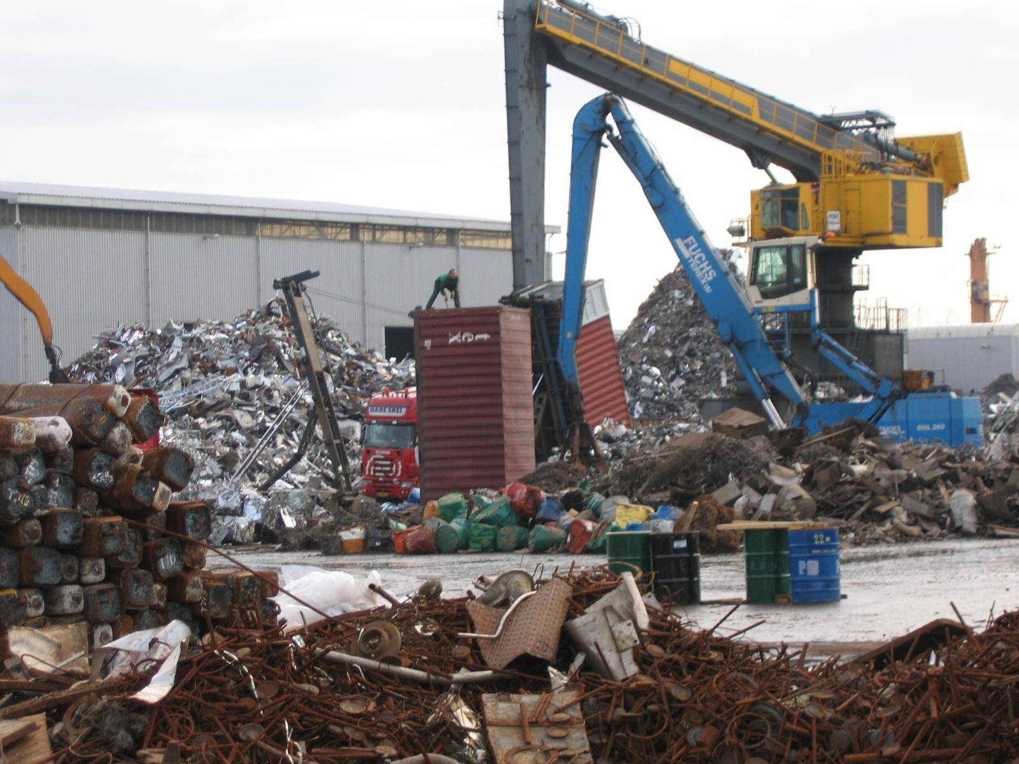
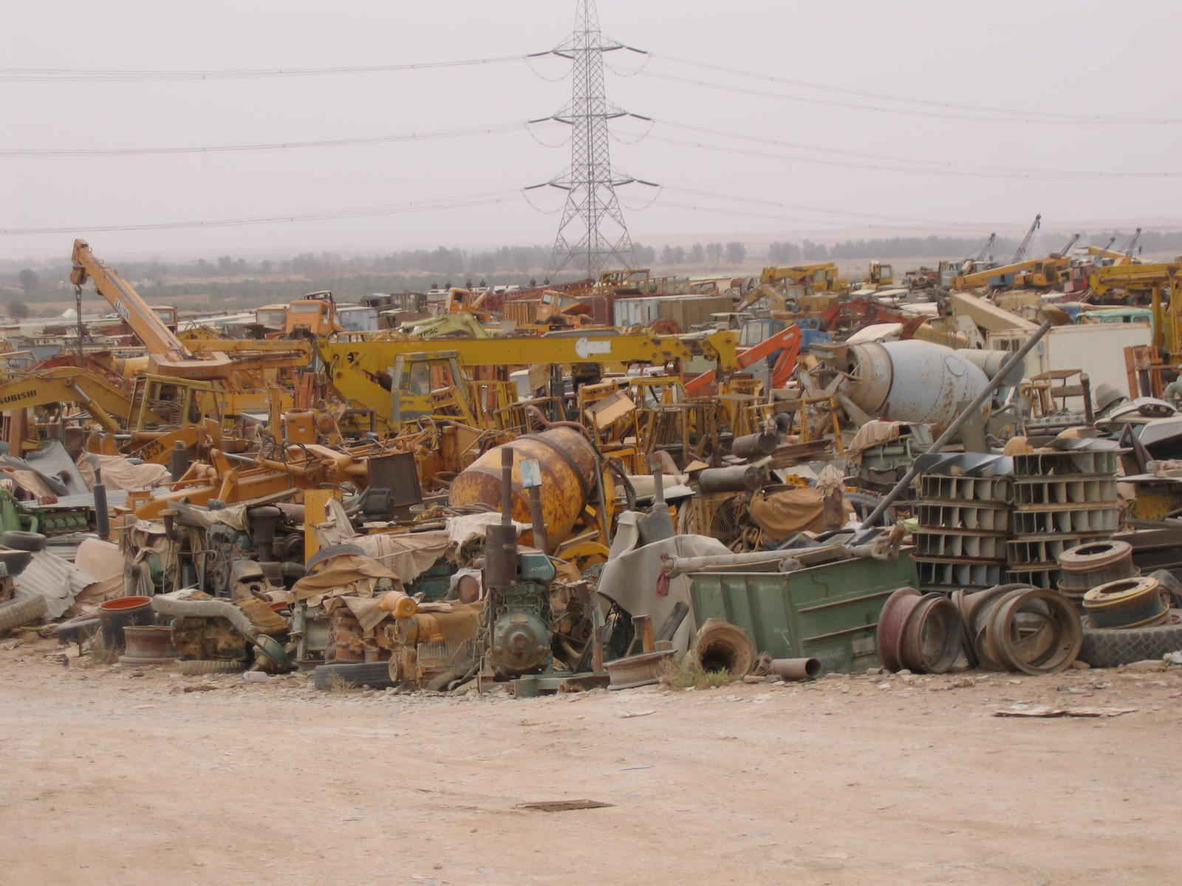
“Thank You” !!
Hopefully presentation was
Informative,
Thought Provoking &
Possibly Entertaining!!!
Never Forget
Safety 1st
Always!!!
Look at this Guy?

